Slide 1
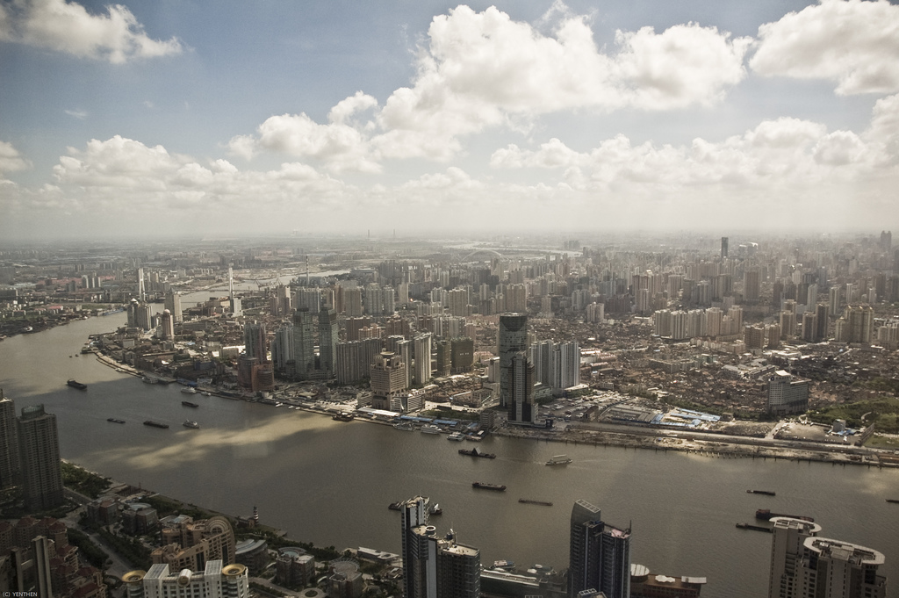
上海锐普广告有限公司
Shanghai Rapidesign Advertising Co.,Ltd
POWERPOINT
ADVERTISING
DESIGN
RAPIDESIGN

Slide 2
Contents
目录
点击添加标题
0
2
Click add title
点击添加标题
0
3
Click add title
PAGE NO.00
点击添加标题
0
4
Click add title
点击添加标题
0
5
Click add title
点击添加标题
0
6
Click add title

Slide 3
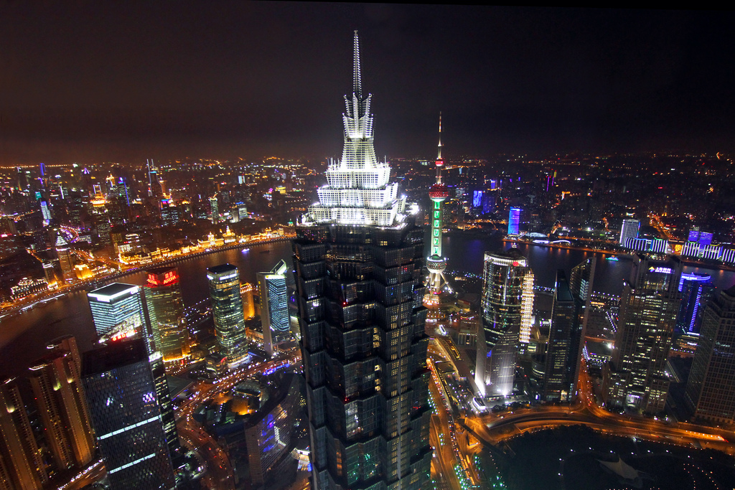
Contents
目录
点击添加标题
0
2
Click add title
点击添加标题
0
3
Click add title
PAGE NO.00
点击添加标题
0
4
Click add title
点击添加标题
0
5
Click add title
点击添加标题
0
6
Click add title

Slide 4
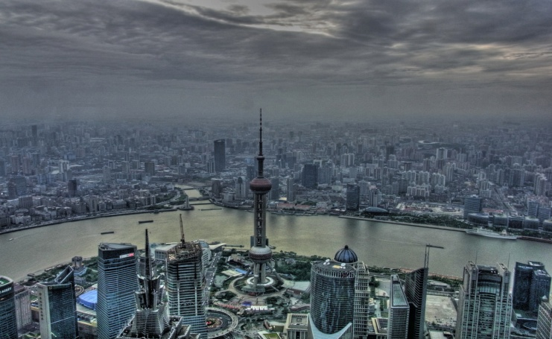

Group introduction
集团简介
PAGE NO.01
上海锐普广告有限公司
是中国第一家精品PPT设计机构。拥有国内顶尖的PPT制作技术、顶级的PPT设计团队， 坚持精益求精、拒绝平庸的做事精神，帮助您实现美观、精致、严谨、动感的PPT展示效果，让您的PPT创造卓越价值。
China's first high-quality goods PPT design agency. With the domestic top PPT manufacture technology, the top PPT design team, adhere to the excelsior, refused to mediocre work spirit, and help you achieve beautiful, delicate, rigorous, dynamic PPT show effect, make your PPT create excellence value.
点击观看

Slide 5
Group introduction
点击添加标题
PAGE NO.02
100%
75%
50%
25%
点击输入标题
点击输入标题
点击输入标题
点击输入标题
独创的结构化目录、过渡页、标题页及精美图表相互衔接，让观众身在其中，却能一目了然。
2005
2006
2007
2008
2009
2010
2011
2012

Slide 6
Group introduction
点击添加标题
PAGE NO.03

Slide 7
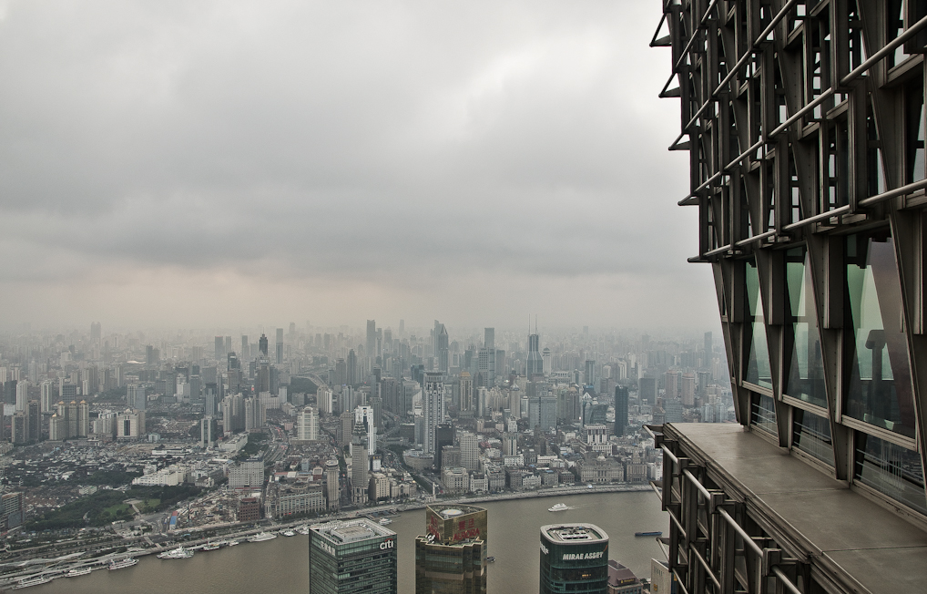
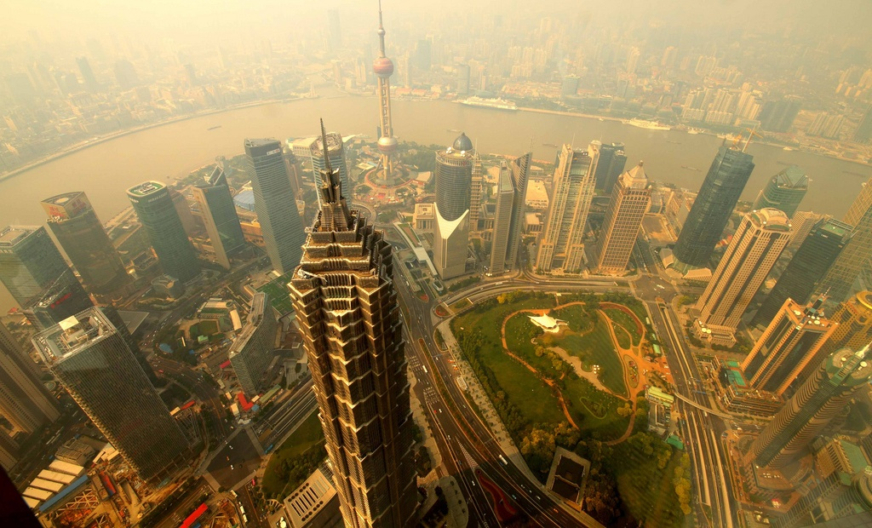
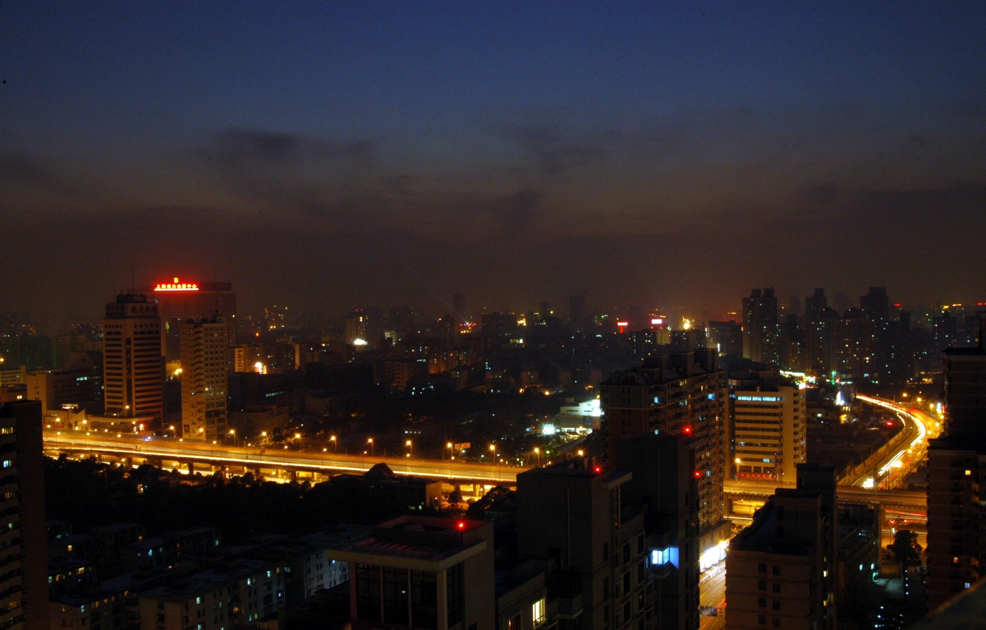
Group introduction
点击添加标题
PAGE NO.04
点击添加标题
点击添加标题
点击添加标题
STANDARD SLIDES
STANDARD SLIDES
STANDARD SLIDES

Slide 8
上海锐普广告有限公司
Shanghai Rapidesign Advertising Co.,Ltd
THANK YOU
POWERPOINT
ADVERTISING
DESIGN
RAPIDESIGN

